Slide 1
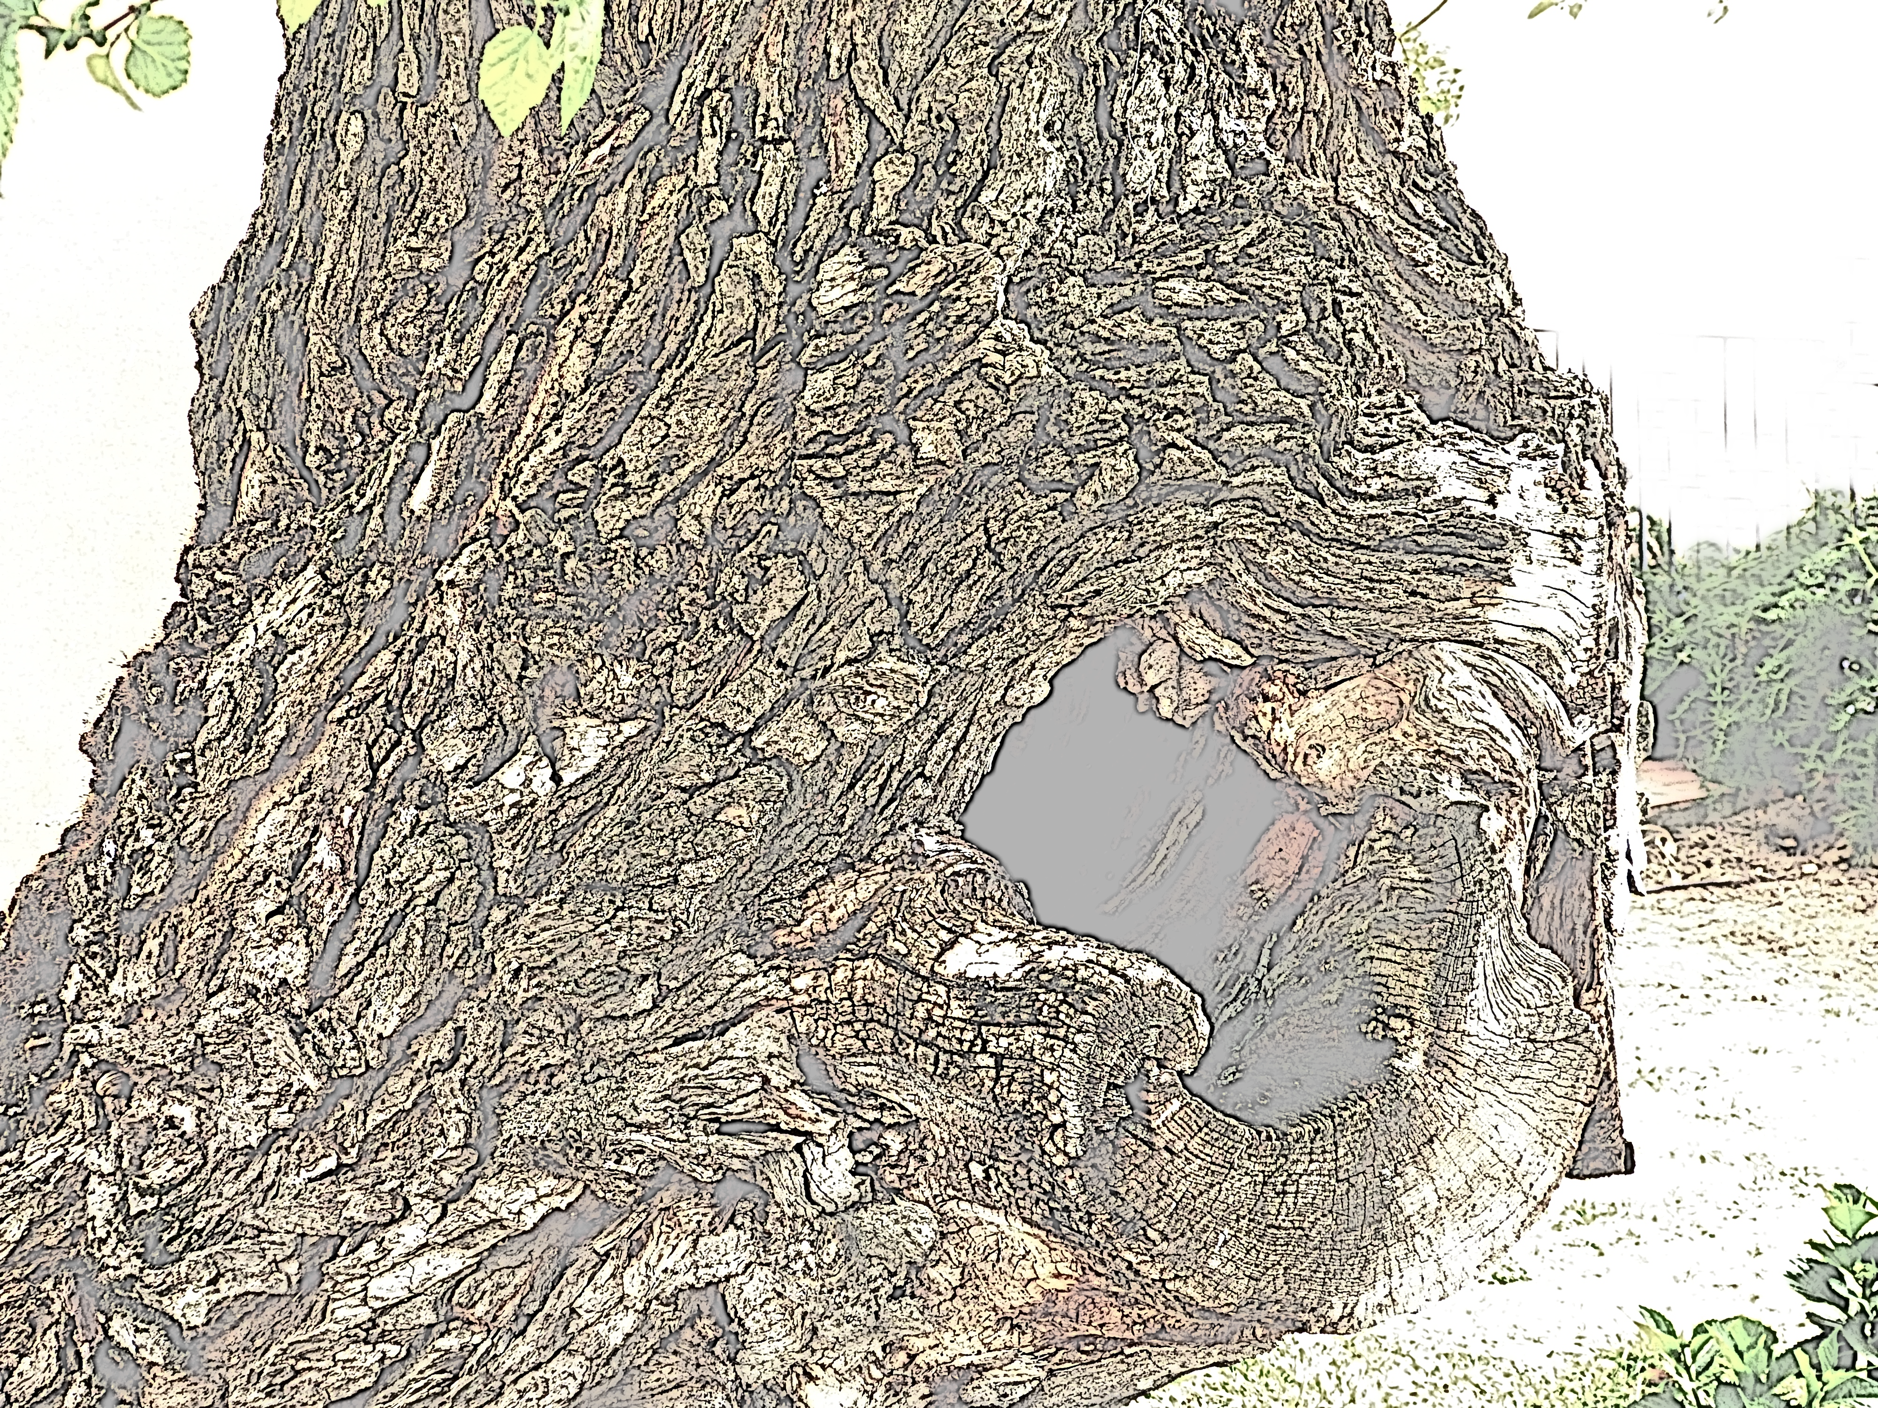
False prophets, idolaters and dead wood
Ezekiel 13:1-15:8

Slide 2
False prophets, idolaters and dead wood
Ezekiel 13:1-15:8
Fake news

Slide 3
False prophets, idolaters and dead wood
Ezekiel 13:1-15:8
Fake news
Two types of false prophets: frauds and psychopaths

Slide 4
False prophets, idolaters and dead wood
Ezekiel 13:1-15:8
Condemnation of false prophets 13:1-7

Slide 5
False prophets, idolaters and dead wood
Ezekiel 13:1-15:8
Condemnation of false prophets 13:1-7
“prophesy out of their own imagination”

Slide 6
False prophets, idolaters and dead wood
Ezekiel 13:1-15:8
Condemnation of false prophets 13:1-7
“prophesy out of their own imagination”
“follow own spirit seeing nothing!”

Slide 7
False prophets, idolaters and dead wood
Ezekiel 13:1-15:8
Condemnation of false prophets 13:1-7
“prophesy out of their own imagination”
“follow own spirit seeing nothing!”
“like jackals among ruins”

Slide 8
False prophets, idolaters and dead wood
Ezekiel 13:1-15:8
Condemnation of false prophets 13:1-7
“prophesy out of their own imagination”
“follow own spirit seeing nothing!”
“like jackals among ruins”
“visions false…divinations a lie”

Slide 9
False prophets, idolaters and dead wood
Ezekiel 13:1-15:8
Condemnation of false prophets 13:1-7
Condemnation of lying visionaries 13: 8-16

Slide 10
False prophets, idolaters and dead wood
Ezekiel 13:1-15:8
Condemnation of false prophets 13:1-7
Condemnation of lying visionaries 13: 8-16
Expelled from council

Slide 11
False prophets, idolaters and dead wood
Ezekiel 13:1-15:8
Condemnation of false prophets 13:1-7
Condemnation of lying visionaries 13: 8-16
Expelled from council
Excluded from citizenship

Slide 12
False prophets, idolaters and dead wood
Ezekiel 13:1-15:8
Condemnation of false prophets 13:1-7
Condemnation of lying visionaries 13: 8-16
Expelled from council
Excluded from citizenship
Excluded from land

Slide 13
False prophets, idolaters and dead wood
Ezekiel 13:1-15:8
Condemnation of false prophets 13:1-7
Condemnation of lying visionaries 13: 8-16
Condemnation of false prophetesses 13:17-23

Slide 14
False prophets, idolaters and dead wood
Ezekiel 13:1-15:8
Condemnation of false prophets 13:1-7
Condemnation of lying visionaries 13: 8-16
Condemnation of false prophetesses 13:17-23
Modern-day examples

Slide 15
False prophets, idolaters and dead wood
Ezekiel 13:1-15:8
Condemnation of false prophets 13:1-7
Condemnation of lying visionaries 13: 8-16
Condemnation of false prophetesses 13:17-23
Modern-day examples
Prayer cloths

Slide 16
False prophets, idolaters and dead wood
Ezekiel 13:1-15:8
Condemnation of false prophets 13:1-7
Condemnation of lying visionaries 13: 8-16
Condemnation of false prophetesses 13:17-23
Modern-day examples
Prayer cloths
“holy water/oil”

Slide 17
False prophets, idolaters and dead wood
Ezekiel 13:1-15:8
Condemnation of false prophets 13:1-7
Condemnation of lying visionaries 13: 8-16
Condemnation of false prophetesses 13:17-23
Modern-day examples
Prayer cloths
“holy water/oil”
“Belief-ism” (positive attitude)

Slide 18
False prophets, idolaters and dead wood
Ezekiel 13:1-15:8
Condemnation of false prophets 13:1-7
Condemnation of lying visionaries 13: 8-16
Condemnation of false prophetesses 13:17-23
God exposed their blindness

Slide 19
False prophets, idolaters and dead wood
Ezekiel 13:1-15:8
Condemnation of false prophets 13:1-7
Condemnation of lying visionaries 13: 8-16
Condemnation of false prophetesses 13:17-23
God exposed their blindness
He challenges our walk.

Slide 20
False prophets, idolaters and dead wood
Ezekiel 13:1-15:8
Condemnation of false prophets 13:1-7
Condemnation of lying visionaries 13: 8-16
Condemnation of false prophetesses 13:17-23
Condemnation of elders 14:1-11

Slide 21
False prophets, idolaters and dead wood
Ezekiel 13:1-15:8
Condemnation of false prophets 13:1-7
Condemnation of lying visionaries 13: 8-16
Condemnation of false prophetesses 13:17-23
Condemnation of elders 14:1-11
God’s answer = unexpected

Slide 22
False prophets, idolaters and dead wood
Ezekiel 13:1-15:8
Condemnation of false prophets 13:1-7
Condemnation of lying visionaries 13: 8-16
Condemnation of false prophetesses 13:17-23
Condemnation of elders 14:1-11
God’s answer = unexpected
Sometimes like that with us – we need to listen

Slide 23
False prophets, idolaters and dead wood
Ezekiel 13:1-15:8
Condemnation of false prophets 13:1-7
Condemnation of lying visionaries 13: 8-16
Condemnation of false prophetesses 13:17-23
Condemnation of elders 14:1-11
God’s answer = unexpected
Sometimes like that with us – we need to listen
Outward presence is not enough

Slide 24
False prophets, idolaters and dead wood
Ezekiel 13:1-15:8
Condemnation of false prophets 13:1-7
Condemnation of lying visionaries 13: 8-16
Condemnation of false prophetesses 13:17-23
Condemnation of elders 14:1-11
God’s answer = unexpected
Sometimes like that with us – we need to listen
Outward presence is not enough
Need to put God first

Slide 25
False prophets, idolaters and dead wood
Ezekiel 13:1-15:8
Condemnation of false prophets 13:1-7
Condemnation of lying visionaries 13: 8-16
Condemnation of false prophetesses 13:17-23
Condemnation of elders 14:1-11
Jerusalem = a useless vine (15:1-8)

Slide 26
False prophets, idolaters and dead wood
Ezekiel 13:1-15:8
Condemnation of false prophets 13:1-7
Condemnation of lying visionaries 13: 8-16
Condemnation of false prophetesses 13:17-23
Condemnation of elders 14:1-11
Jerusalem = a useless vine (15:1-8)
Inevitable judgment (14:12-21)

Slide 27
False prophets, idolaters and dead wood
Ezekiel 13:1-15:8
Condemnation of false prophets 13:1-7
Condemnation of lying visionaries 13: 8-16
Condemnation of false prophetesses 13:17-23
Condemnation of elders 14:1-11
Jerusalem = a useless vine (15:1-8)
Inevitable judgment (14:12-21)
Lessons

Slide 28
False prophets, idolaters and dead wood
Ezekiel 13:1-15:8
Condemnation of false prophets 13:1-7
Condemnation of lying visionaries 13: 8-16
Condemnation of false prophetesses 13:17-23
Condemnation of elders 14:1-11
Jerusalem = a useless vine (15:1-8)
Inevitable judgment (14:12-21)
Lessons
God is never the author of sin

Slide 29
False prophets, idolaters and dead wood
Ezekiel 13:1-15:8
Condemnation of false prophets 13:1-7
Condemnation of lying visionaries 13: 8-16
Condemnation of false prophetesses 13:17-23
Condemnation of elders 14:1-11
Jerusalem = a useless vine (15:1-8)
Inevitable judgment (14:12-21)
Lessons
God is never the author of sin
Judgment against sin is inevitable

Slide 30
False prophets, idolaters and dead wood
Ezekiel 13:1-15:8
Condemnation of false prophets 13:1-7
Condemnation of lying visionaries 13: 8-16
Condemnation of false prophetesses 13:17-23
Condemnation of elders 14:1-11
Jerusalem = a useless vine (15:1-8)
Inevitable judgment (14:12-21)
Lessons
God is never the author of sin
Judgment against sin is inevitable
Pruning is not judgment

